Slide 1
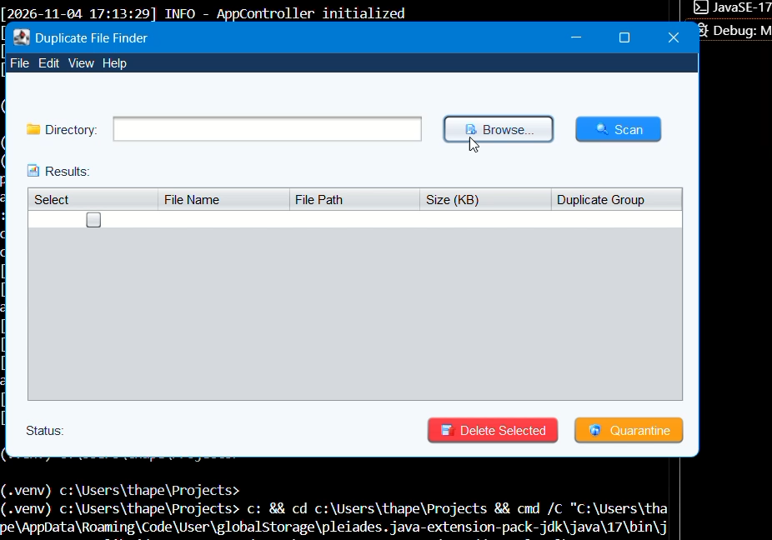
CPUT
CAPE PENINSULA UNIVERSITY OF TECHNOLOGY
Group 26 presents
Duplicate
File Finder
Find identical files. Review them. Manage extra copies safely.
A Java application for clear, controlled duplicate-file review.
CPUT · Software Design 2

Slide 2
CPUT
CPUT
CAPE PENINSULA UNIVERSITY OF TECHNOLOGY
GROUP 26
01
Introduction
The Problem · The Solution· The Team
DUPLICATE FILE FINDER · SOFTWARE DESIGN 2
Notes:
Ntokozo introduces the project and previews the problem, purpose and team. (0:08)

Slide 3
The Team
The Solution
The Problem
The problem: duplicate copies waste space
The same content can be saved in several locations or under different filenames.
THE IMPACT
Silent Storage Bloat
Name-based searches miss renamed copies. Comparing every file pair is costly.
Gigabytes lost to redundant downloads, backups, and uncompressed media.
Review Paralysis
Fear of breaking projects or losing data prevents users from cleaning up.
Performance Degradation
Cluttered file systems slow down indexing, searching, and routine maintenance.
Purpose: make duplicate review clear and controlled.
Notes:
Ntokozo introduces the project and previews the problem, purpose and team. (0:08)

Slide 4
The Team
The Solution
We built a Java tool for duplicate-file review
Content-aware file management with zero guesswork
1
2
3
The Problem
The problem: duplicate copies waste space
The same content can be saved in several locations or under different filenames.
THE IMPACT
Silent Storage Bloat
Name-based searches miss renamed copies. Comparing every file pair is costly.
Gigabytes lost to redundant downloads, backups, and uncompressed media.
Review Paralysis
Fear of breaking projects or losing data prevents users from cleaning up.
Performance Degradation
Cluttered file systems slow down indexing, searching, and routine maintenance.
Purpose: make duplicate review clear and controlled.
Notes:
Ntokozo introduces the project and previews the problem, purpose and team. (0:08)

Slide 5
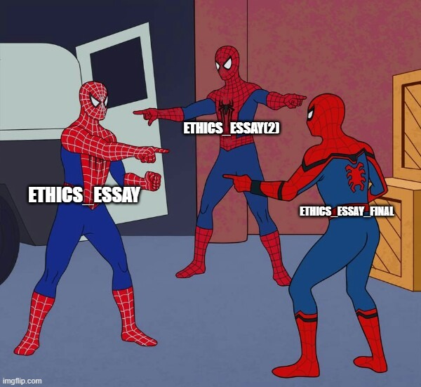
The Team
The Solution
We built a Java tool for duplicate-file review
Content-aware file management with zero guesswork
2
3
Find Duplicate Content
The Problem
The problem: duplicate copies waste space
The same content can be saved in several locations or under different filenames.
THE IMPACT
Silent Storage Bloat
Name-based searches miss renamed copies. Comparing every file pair is costly.
Gigabytes lost to redundant downloads, backups, and uncompressed media.
Review Paralysis
Fear of breaking projects or losing data prevents users from cleaning up.
Performance Degradation
Cluttered file systems slow down indexing, searching, and routine maintenance.
Purpose: make duplicate review clear and controlled.
Notes:
Ntokozo introduces the project and previews the problem, purpose and team. (0:08)

Slide 6
The Team
The Solution
We built a Java tool for duplicate-file review
Content-aware file management with zero guesswork
3
Find Duplicate Content
Review the copies
The Problem
The problem: duplicate copies waste space
The same content can be saved in several locations or under different filenames.
THE IMPACT
Silent Storage Bloat
Name-based searches miss renamed copies. Comparing every file pair is costly.
Gigabytes lost to redundant downloads, backups, and uncompressed media.
Review Paralysis
Fear of breaking projects or losing data prevents users from cleaning up.
Performance Degradation
Cluttered file systems slow down indexing, searching, and routine maintenance.
Purpose: make duplicate review clear and controlled.
Notes:
Ntokozo introduces the project and previews the problem, purpose and team. (0:08)

Slide 7
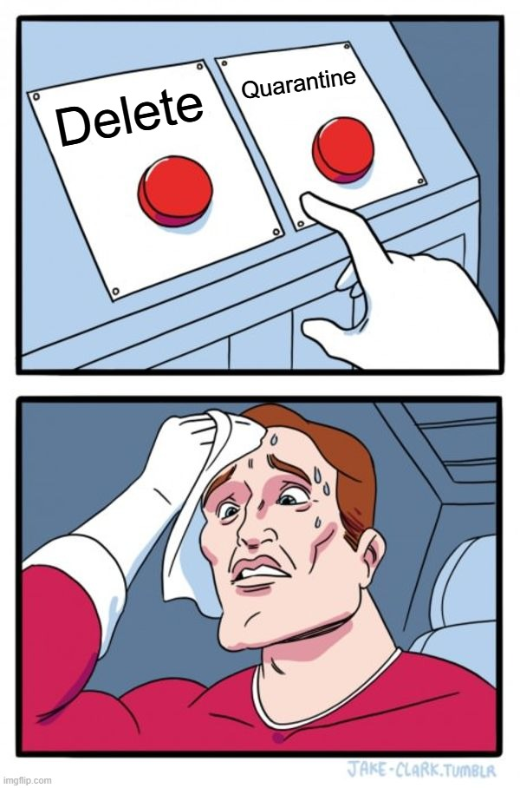
The Team
The Solution
We built a Java tool for duplicate-file review
Content-aware file management with zero guesswork
Find Duplicate Content
Review the copies
Choose what happens next
The Problem
The problem: duplicate copies waste space
The same content can be saved in several locations or under different filenames.
THE IMPACT
Silent Storage Bloat
Name-based searches miss renamed copies. Comparing every file pair is costly.
Gigabytes lost to redundant downloads, backups, and uncompressed media.
Review Paralysis
Fear of breaking projects or losing data prevents users from cleaning up.
Performance Degradation
Cluttered file systems slow down indexing, searching, and routine maintenance.
Purpose: make duplicate review clear and controlled.
Notes:
Ntokozo introduces the project and previews the problem, purpose and team. (0:08)

Slide 8
The Team
Ntokozo
HashCalculator Developer
Nkazimulo
CLI Developer
Mahlogonolo
FileScanner Developer
Kungawo
GUI Developer
Lethabo
Project Lead / Integrator
Amogelang
Testing & QA Lead
Thapelo
DuplicateDetector Developer
Nobuhle
Documentation & UML Lead
The Solution
The Problem
The problem: duplicate copies waste space
We built a Java tool for duplicate-file review
The same content can be saved in several locations or under different filenames.
Content-aware file management with zero guesswork
THE IMPACT
Silent Storage Bloat
Name-based searches miss renamed copies. Comparing every file pair is costly.
Gigabytes lost to redundant downloads, backups, and uncompressed media.
Review Paralysis
Fear of breaking projects or losing data prevents users from cleaning up.
Performance Degradation
Cluttered file systems slow down indexing, searching, and routine maintenance.
Purpose: make duplicate review clear and controlled.
Find Duplicate Content
Review the copies
Choose what happens next
Notes:
Ntokozo introduces the project and previews the problem, purpose and team. (0:08)

Slide 9
CPUT
CPUT
CAPE PENINSULA UNIVERSITY OF TECHNOLOGY
GROUP 26
02
System Design
Architecture · detection logic · data flow
DUPLICATE FILE FINDER · SOFTWARE DESIGN 2
The problem: duplicate copies waste space
We built a Java tool for duplicate-file review
The same content can be saved in several locations or under different filenames.
Content-aware file management with zero guesswork
Ntokozo
Project Lead / Integrator
THE IMPACT
Nkazimulo
CLI Developer
Silent Storage Bloat
Name-based searches miss renamed copies. Comparing every file pair is costly.
Gigabytes lost to redundant downloads, backups, and uncompressed media.
Mahlogono
FileScanner Developer
Kungawo
GUI Developer
Review Paralysis
Lethabo
HashCalculator Developer
Amogelang
Testing & QA Lead
Fear of breaking projects or losing data prevents users from cleaning up.
Performance Degradation
Thapelo
DuplicateDetector Developer
Buhle
Documentation & UML Lead
Cluttered file systems slow down indexing, searching, and routine maintenance.
Purpose: make duplicate review clear and controlled.
Find Duplicate Content
Review the copies
Choose what happens next
Notes:
Ntokozo introduces the project and previews the problem, purpose and team. (0:08)

Slide 10
SYSTEM DESIGN
UML class diagram: interfaces call a central controller
Main (Swing GUI)
FileScanner
controller: AppController
scanDirectory(Path)
filters and walks folders
AppController
DuplicateDetector
creates
DuplicateGroup<File>
CLIMenu (CLI)
settings: AppSettings
findDuplicates(files)
hash · fileSize · files
controller: AppController
uses
scanner · detector · hashing · quarantine
coordinates
groups by size, then hash
one group per matching hash
hashes
HashCalculator
QuarantineWindow
calculateHashes(files)
controller: AppController
parallel SHA-256
loads settings
QuarantineManager
ReportGenerator
AppSettings
quarantineAll() · restoreAll()
exportToCsv()
threadPoolSize · minFileSize
records original paths
exportToJson()
extensionFilter · quarantinePath
uses for CSV / JSON export
Solid links show references or calls. ReportGenerator is created when an export is requested.
Notes:
Buhle (0:35) presents the UML: Main, CLIMenu and QuarantineWindow each send user actions through AppController. AppController coordinates AppSettings and the scanner, detector, hashing and quarantine services. Thapelo (0:25) explains that DuplicateDetector uses HashCalculator and produces DuplicateGroup results; AppController calls ReportGenerator when CSV or JSON export is requested. MainApp and WelcomeScreen handle startup, while Logger, HashUtil and FileUtility are supporting classes left off this focused diagram.

Slide 11
ALGORITHM
Duplicate detection uses a two-stage comparison
2
3
4
1
Size buckets
Parallel hash
Duplicate groups
Candidate scan
Only same-size files remain candidates
SHA-256 for eligible candidates
Same hash → DuplicateGroup
Directory walk + filters
Data structures
Map<size, files>
Map<hash, files>
List<DuplicateGroup<File>>
Equal names are not required; matching content is.
Notes:
Mahlogono (0:25): FileScanner walks directories and applies minimum-size and extension filters. Lethabo (0:25): HashCalculator computes SHA-256 hashes in parallel; DuplicateDetector first buckets by file size, then compares hashes only for same-size candidates. Maps and lists hold the buckets and duplicate groups.

Slide 12
ALGORITHM
Duplicate detection uses a two-stage comparison
1
2
3
4
Candidate scan
Size buckets
Parallel hash
Duplicate groups
Directory walk + filters
Only same-size files remain candidates
SHA-256 for eligible candidates
Same hash → DuplicateGroup
Data structures
Map<size, files>
Map<hash, files>
List<DuplicateGroup<File>>
Equal names are not required; matching content is.
Notes:
Mahlogono (0:25): FileScanner walks directories and applies minimum-size and extension filters. Lethabo (0:25): HashCalculator computes SHA-256 hashes in parallel; DuplicateDetector first buckets by file size, then compares hashes only for same-size candidates. Maps and lists hold the buckets and duplicate groups.

Slide 13
SYSTEM OVERVIEW
A scan moves from folder to decision
02
03
04
05
01
Filter
Compare
Review
Manage
Choose
Size + extension
Size, then SHA-256
Inspect duplicate groups
Export or quarantine
Select a directory
GUI: visual results table
CLI: menu-driven workflow
Same controller and file services support both entry points.
Notes:
Kungawo (0:35): explain the scan workflow. FileScanner filters files; DuplicateDetector checks candidates; the GUI and CLI both use AppController and the same core services.

Slide 14
SYSTEM OVERVIEW
A scan moves from folder to decision
01
02
03
04
05
Choose
Filter
Compare
Review
Manage
Select a directory
Size + extension
Size, then SHA-256
Inspect duplicate groups
Export or quarantine
GUI: visual results table
CLI: menu-driven workflow
Same controller and file services support both entry points.
Notes:
Kungawo (0:35): explain the scan workflow. FileScanner filters files; DuplicateDetector checks candidates; the GUI and CLI both use AppController and the same core services.

Slide 15
CPUT
CPUT
CAPE PENINSULA UNIVERSITY OF TECHNOLOGY
GROUP 26
03
Application Demonstration
Folder to scan
The Java application in action
DUPLICATE FILE FINDER · SOFTWARE DESIGN 2
Notes:
Ntokozo introduces the project and previews the problem, purpose and team. (0:08)

Slide 16
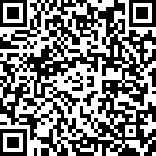
CONCLUSION
A practical tool for finding and managing duplicates
We built a Java application that scans, verifies, groups and manages duplicate files.
Scan
Verify
Review
Manage safely
Presenters
GitHub repository
Ntokozo · Mahlogonolo · Lethabo · Thapelo
Nkazimulo · Kungawo · Amogelang · Nobuhle
Thank you
github.com/LETHABO113/Duplicate-File-Finder
Notes:
Ntokozo closes (0:20): restate the result and thank the audience. Ensure all eight people have spoken. The repository link shown is https://github.com/LETHABO113/Duplicate-File-Finder; include it in the final report. Planned total is about 9 minutes 47 seconds, within the 7–10 minute limit.

